Slide 1
Hardware Software Platforms Project Presentation
Measuring temperature on TMP100
NAJI Doha (doha.naji@student.umons.ac.be)
HOEDENAEKEN Clément
(clement.hoedenaeken@student.umons.ac.be)

Slide 2
Table of contents
A) Introduction
B) Steps of the design
1. I2C driver
2. Bloc (control state machine)
3. Main.c (data => PC)
C) Demonstration video
E) Conclusion

Slide 3
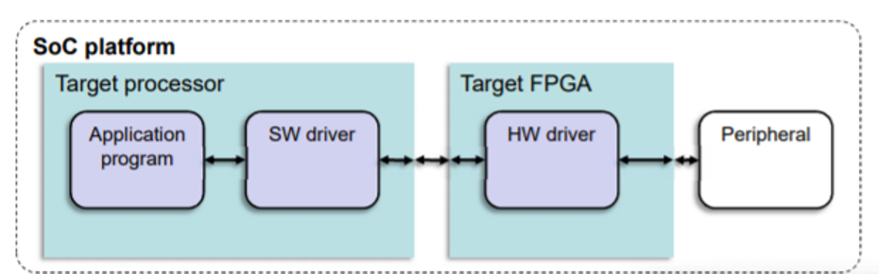
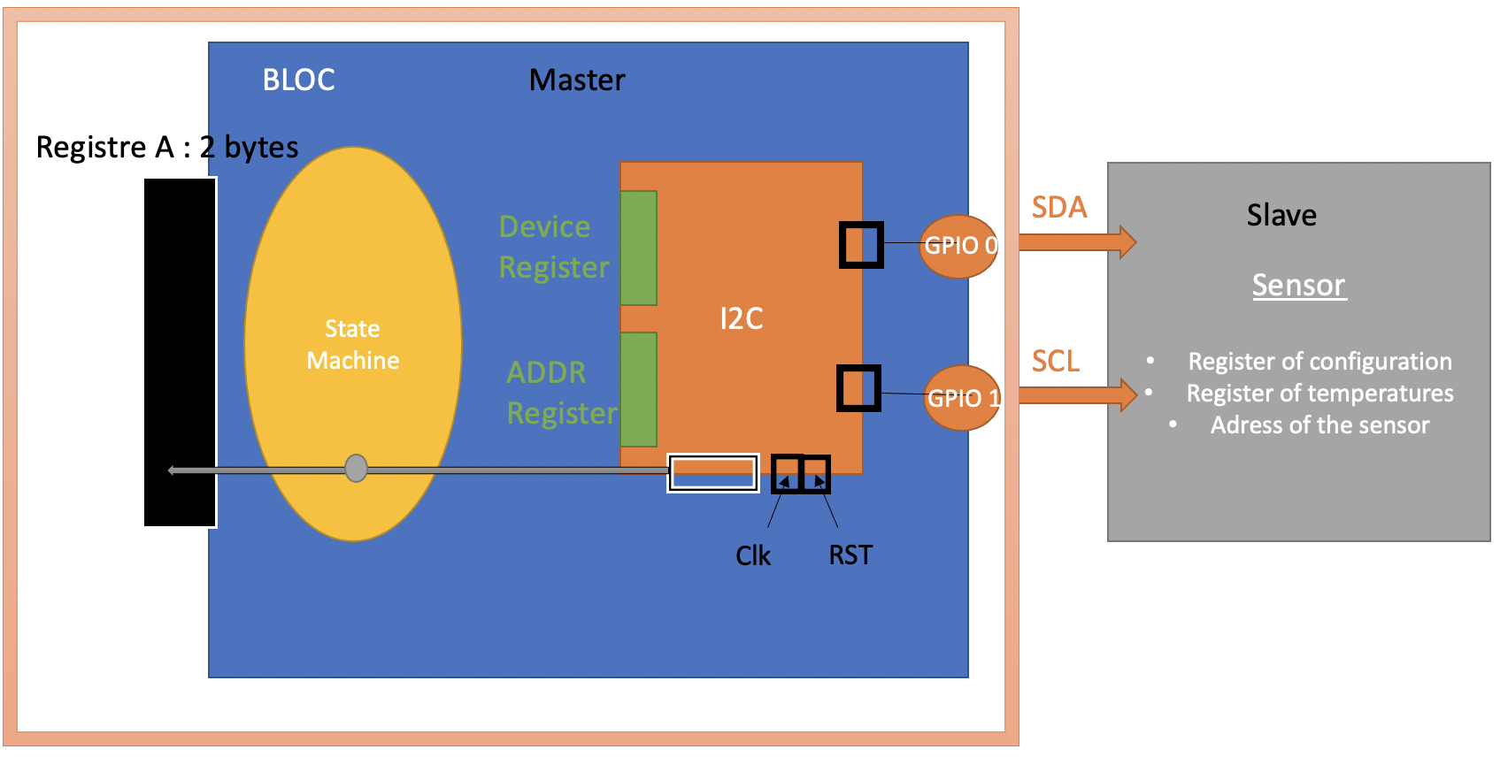
A) Introduction
Objective : create a tutorial based on Quartus and DE0 kits
interaction with peripheral
Control driver and interaction with the environment

Slide 4
B) Steps of the design

Slide 5
1. I2C driver : context
* Implemented on FPGA in VHDL
* Pilots the TMP100 Temperature Sensor
* Uses I2C protocol and bus

Slide 6
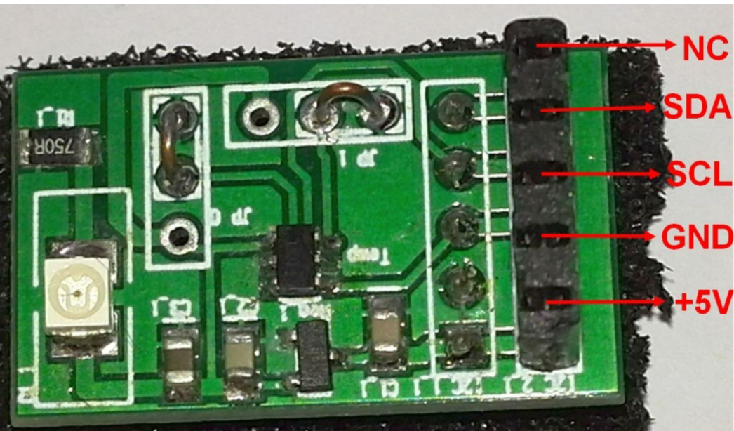
1. I2C driver : I2C protocol and bus
Half-duplex bidirectional synchronous serial bus
One element speaks at a time
Communication possible in both direction
Clock signal to synchronize the communication
One bit sent at a time
2 wire-interface:
1 wire for the Data : SDA
1 wire for the Clock : SCL
+ 2 for power supply

Slide 7
1. I2C driver : I2C protocol and bus
The first who takes the control of the bus becomes the master. It generates the start Condition. The other one becomes the slave.
1
Star Condition
SDA
0
(Bus busy)
SCL
1
1
SDA
0
Stop Condition
1
(Bus free)
SCL

Slide 8
1. I2C driver : I2C protocol and bus
1) Master
Slave
Start Condition : The master puts the line to 0 + generation of the clock
At each rising edge, sending of a bit of the slave address (8 bits : 8th bit = R/W)
The master puts the line to 1 untill the slave puts the line back to 0 (ACK) : the communication begins at the next rising edge.
The master puts the line to 1 untill the slave puts it back to 0:
ACK --> Stop Condition

Slide 9
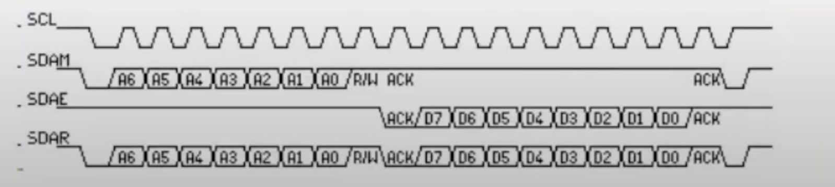
1. I2C driver : I2C protocol and bus
2) Slave
Master
Start Condition (similary to the master/slave communication)
At each rising edge, sending of a bit of the address of the slave
The Master puts the line into1 untill the slave puts back the line to zéro (ACK) + sending of the data
The slave puts the line to 1 untill the master puts the line back to 0 : ACK --> Stop Condition

Slide 10
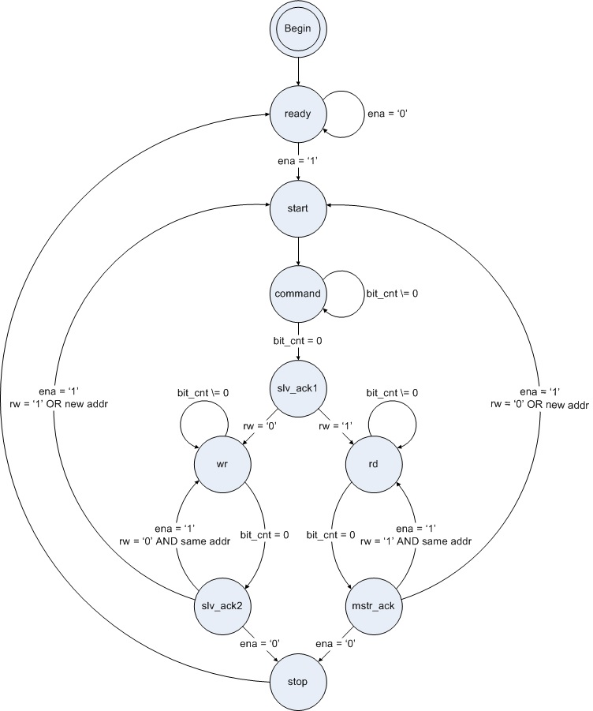
1. I2C driver : I2C protocol and bus
Start condition
Slave address writing
Writing loop
Reading loop
End condition

Slide 11
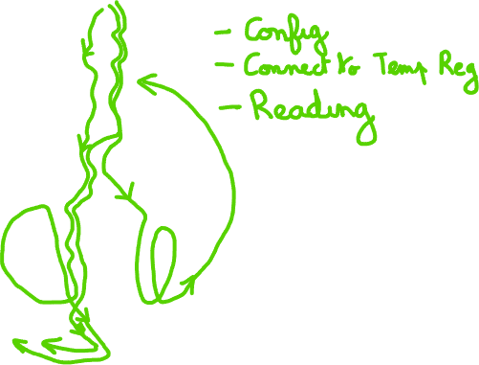
1. I2C driver : I2C protocol and bus
Writing the configuration
Connecting the temperature register
Reading the temperature
(Given by the sensor datasheet)

Slide 12
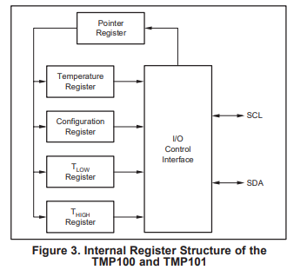
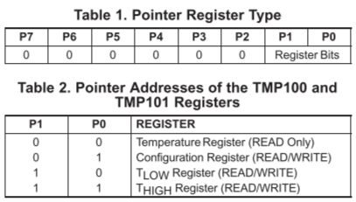
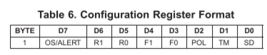
1. I2C driver : configuration of the sensor
Slave address : 1001 000
Configuration of the sensor : 12 bits
Write address of config register
Write the config (01100000)
Write the address of temp register
Read temp register

Slide 13
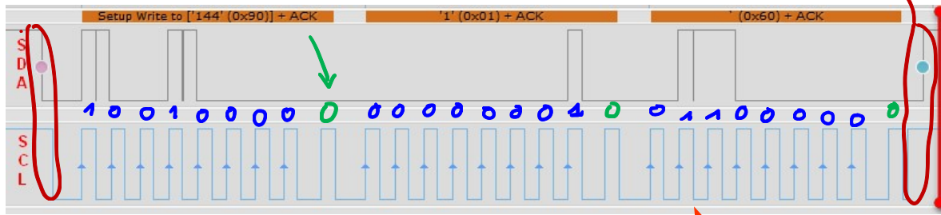
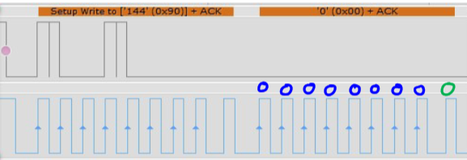
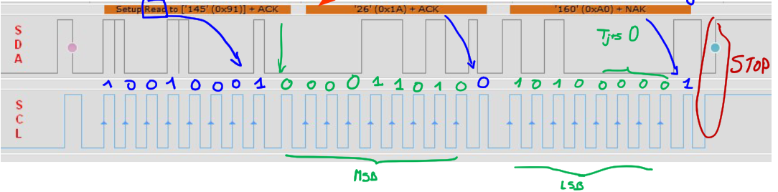
1. I2C driver : the signals we want to produce
Writing the configuration
Writing connecting the temperature register
Delay : min 320 ms
Reading the temperature

Slide 14
2. Bloc (control state machine)
State machine to control the I2C driver and process the data

Slide 15
2. Bloc (control state machine)
Objective : Drive this state machine (follow the colored paths)
Action : Place values in the registers and activate right signals at the right moment (e.g. : enable, rw,…)
Help : Flags raised by the machine (e.g. : busy, val_rdy, reg_rdy,…)

Slide 16
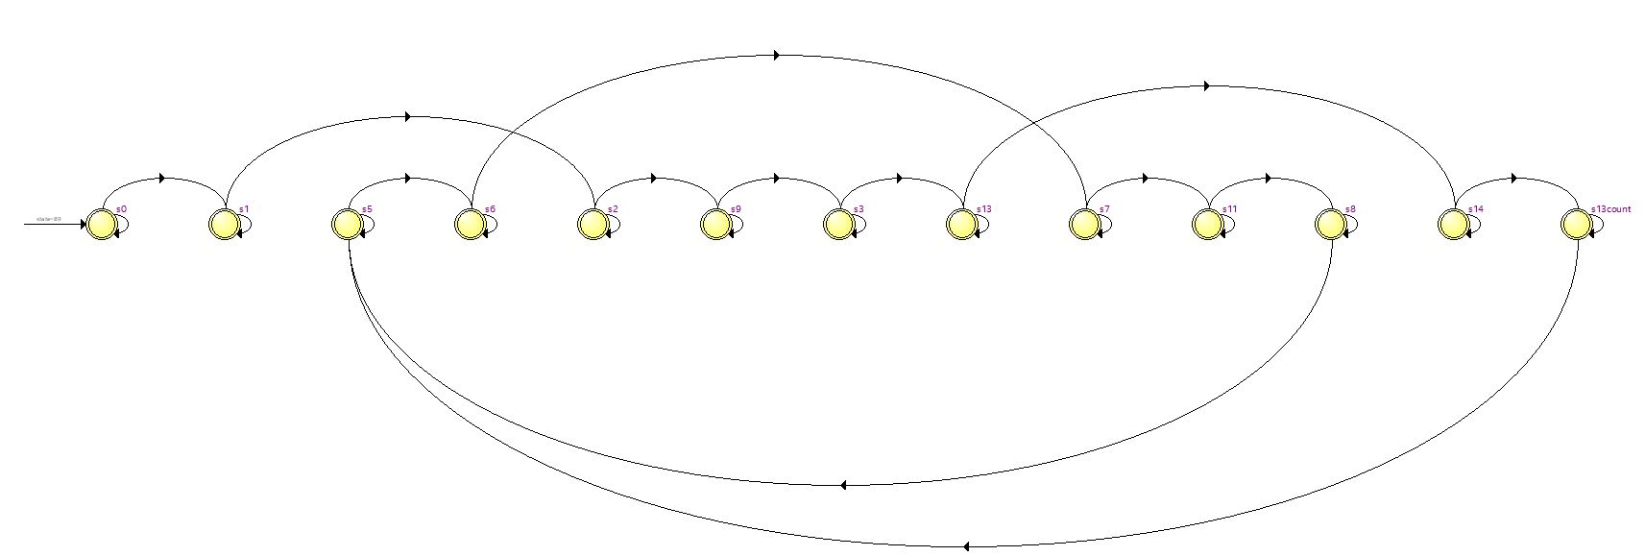
2. Bloc (control state machine)

Slide 17
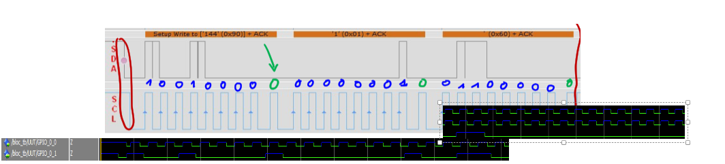
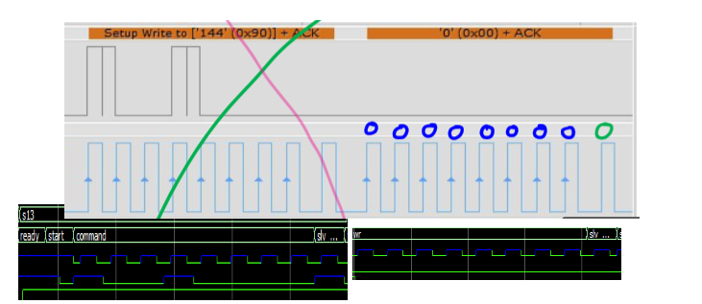
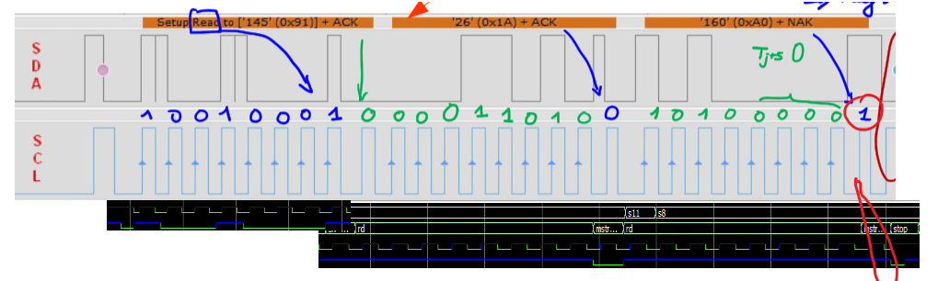
2. Bloc (control state machine) : testing it with a testbench
Writing the configuration
Writing connecting the temperature register
Reading the temperature

Slide 18

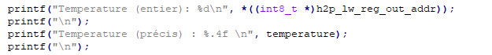
3. Main.C
SoC
Terminal/Putty
ARM
FPGA
Terminal/Putty
Serial Protocol Communication

Slide 19
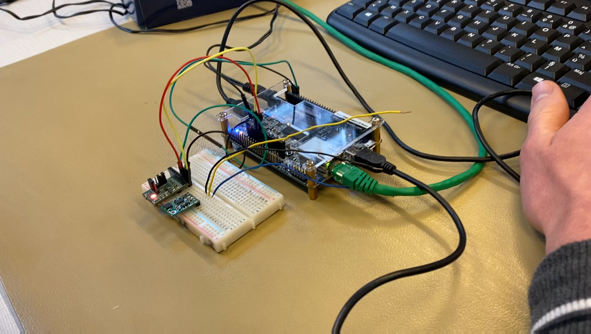
C) Demonstration video

Slide 20
D) Conclusion
 | Working | Tested
Driver I²C | ✅ | Modelsim : ✅
Control State Machine (Bloc) | ❌ (clock not working) | Modelsim :✅ Oscilloscope : ❌
Code in C | ✅ (reads « 0°C ») | ✅

Slide 21
Thank you !
Questions?

